Slide 1
OBJECT-ORIENTED ANALYSIS AND DESIGN
Grady Booch

Slide 2
Grady Booch, Chief Scientist at Rational Software Corporation, is
recognized throughout the international software development
community for his pioneering work in object methods and applications.
He is a featured columnist in Object Magazine and C++ Report, and
the author of several best-selling books on software engineering and
object-oriented development.
Grady Booch also edits and contributes to the Object-Oriented
Software Engineering Series published by Addison-Wesley

Slide 3
Complexity
A physician, a civil engineer, and a computer scientist were arguing about what was the
oldest profession in the world.
---------------------------------------------------------------------------------------------------------------------
The physician remarked, "Weil, in the Bible, it says that God
created Eve from a rib taken out of Adam. This clearly required surgery, and so I can rightly
claim that mine is the oldest profession in the world."
The civil engineer interrupted, and said,
"But even earlier in the book of Genesis, it states that God created the order of the heavens
and the earth from out of the chaos. This was the first and certainly the most spectacular
application of civil engineering.
fair doctor, you are wrong: mine is the oldest
profession in the world."
The computer scientist leaned back in her chair, smiled, and then
said confidently, "Ah, but who do you think created the chaos?"

Slide 4
Complexity
A dying star on the verge of collapse
A child learning how to read
White blood cells rushing to attack a virus
Software may also involve elements of great complexity

Slide 5
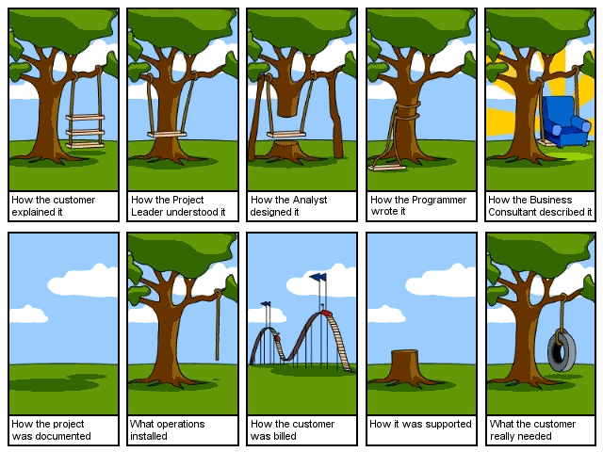
Why Object-Oriented?

Slide 6
Complexity of the Software System
Internal Complexity
Arises from the composition of a system itself
External Complexity
Arises from the fact that users themselves have only a vague idea of how their system works and have difficulty in expressing their requirements

Slide 7
Why Software Is Inherently Complex
"The complexity of software is an essential property, not an accidental one"
The complexity of the problem domain,
The difficulty of managing the developmental process,
The flexibility possible through software,
The problems of characterizing the behavior of discrete systems.

Slide 8
Reasons for the Complexity Involved in the Development of Software
Lack of standards for developing software
Difficulty in predicting software behavior
“The "software crises" came about when people realized the major problems in software development were … caused by communication difficulties and the management of complexity”

Slide 9
Simplifying Complexity
Is done by breaking the system into its component parts and arranging them in a hierarchy

Slide 10
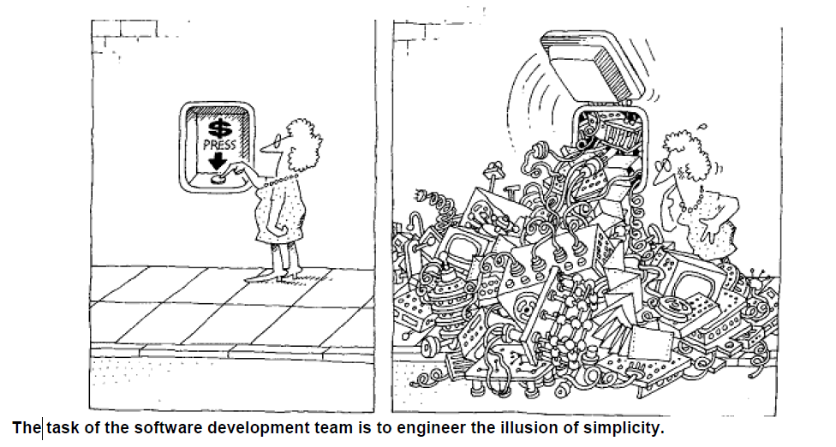

Slide 11
Examples of Complex Systems
The Structure of a Personal Computer
The Structure of Plants and Animals
The Structure of Matter
The Structure of Social Institutions

Slide 12
The Five Attributes of a Complex System,
1. "Frequently, complexity takes the form of a hierarchy, whereby a complex system is composed of interrelated subsystems that have in turn their own subsystems, and so on, until some lowest level of elementary components is reached“
2. The choice of what components in a system are primitive is relatively arbitrary and is largely up to the discretion of the observer of the system.
3. “Intra component linkages are generally stronger than intercommoning linkages. This fact has the effect of separating the high-frequency dynamics of the components - involving the internal structure of the components - from the low-frequency dynamics - involving interaction among components“
4. "Hierarchic systems are usually composed of only a few different kinds of subsystems in various combinations and arrangements “
5. “A complex system that works is invariably found to have evolved from a simple system that worked.... A complex system designed from scratch never works and cannot be patched up to make it work. You have to start over, beginning with a working simple system "

Slide 13
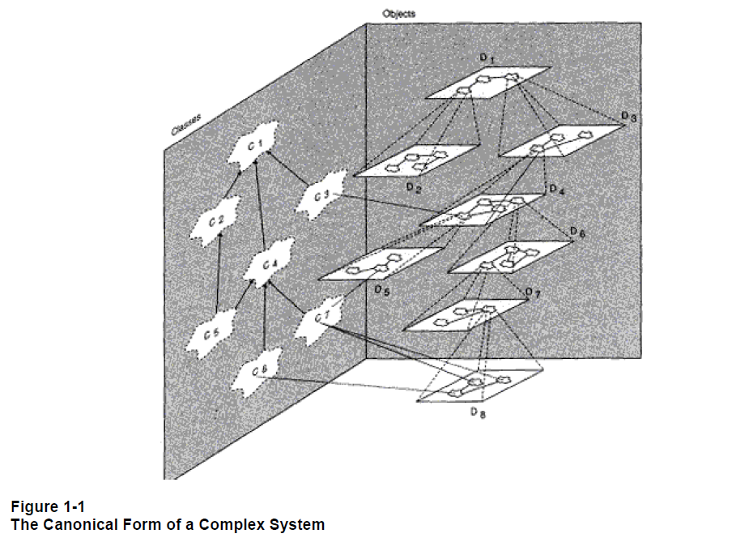
Class structure
"is a" hierarchy
Object structure
"part of " hierarchy
Two orthogonal hierarchies of the system
The class structure and the object structure are not completely independent; rather, each object in the object structure represents a specific instance of some class.

Slide 14
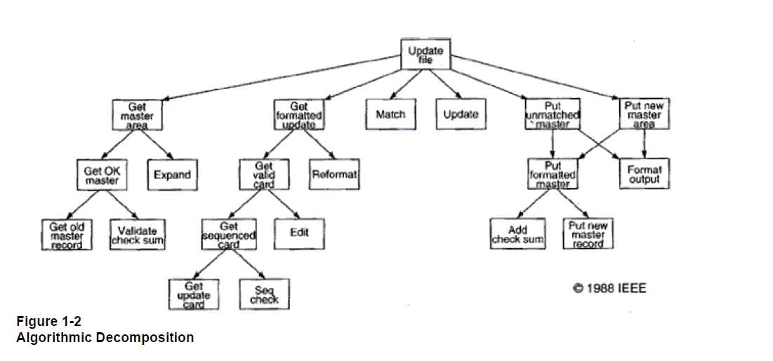
Structure chart illustrates part of the design of a program that updates the content of master file.
Automatically generated from DFD by an Expert system tool

Slide 15
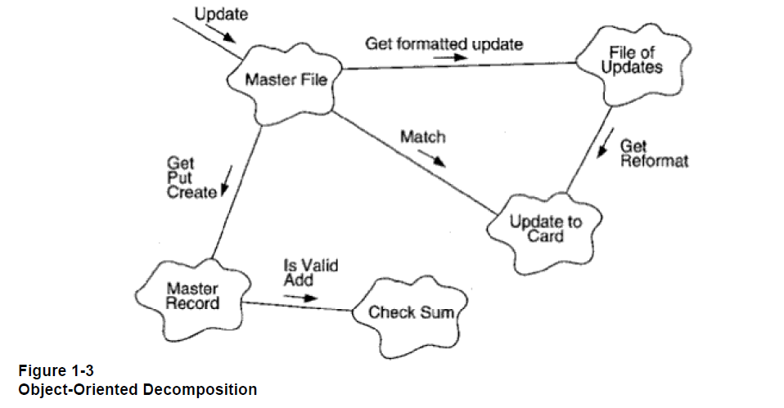
Decomposed the system according to the key abstractions in the problem domain.

Slide 16
Algorithmic versus Object-Oriented Decomposition
Which is the right way to decompose
a complex system - by algorithms or by objects?

Slide 17
Answer
Object-oriented decomposition directly addresses the inherent complexity of
software by helping us make intelligent decisions regarding the separation of concerns in a large state space.
object is tangible entity
object exhibits well defined behavior
object do things, passing messages

Slide 18
Benefits of the Object-Oriented Approach
Realistic modeling
Easy to use
Reusability
Saves time and cost
Resilience to change
Easy to maintain
Parts of the system can be refined without any major change in other parts

Slide 19
Object oriented technology has indeed moved into the mainstream of industrial-strength software.
Diverse domains
Banking transaction
Automation of bowling alleys
Management of public utilities
Mapping of human genome
Next generation OS
DB systems
Telephony Systems
Avionics systems
Multimedia application
OOP Techniques :
CAD, CAM, AI and expert System, OO Database
Why ?
No other way to economically produce an enduring and resilient programming system

Slide 20
Object-Oriented Analysis (OOA)
Analysis:
Is a phase where users and developers get together and arrive at a common understanding of the system
Requires the developer to concentrate on obtaining maximum possible information about the problem domain
Results in one of the end products as specification of the function of the system
Object-oriented analysis is a method of analysis that examines requirements from the perspective of
the classes and objects found in the vocabulary of the problem domain.

Slide 21
Object-Oriented Design (OOD)
Design:
Generates the blueprint of the system that has to be implemented
Involves identifying classes using
Abbott’s technique
Write English description of the problem
Underline nouns (nouns represent candidate classes)
Object-oriented design is a method of design encompassing the process of object-oriented
decomposition and a notation for depicting both logical and physical as well as static and dynamic
models of the system under design.

Slide 22
What is OOAD?
Analysis — understanding, finding and describing concepts in the problem domain.
Design — understanding and defining software solution/objects that represent the analysis concepts and will eventually be implemented in code.
OOAD — Analysis is object-oriented and design is object-oriented. A software development approach that emphasizes a logical solution based on objects.
Involves both a notation and a process

Slide 23
How to Do OOAD – Where to Use OO?
Software Lifecycle
Systems Engineering
Requirements Analysis
Quality Assurance
Project Planning
Maintenance
Architectural Design
Detailed Design
Implementation
Release

Slide 24

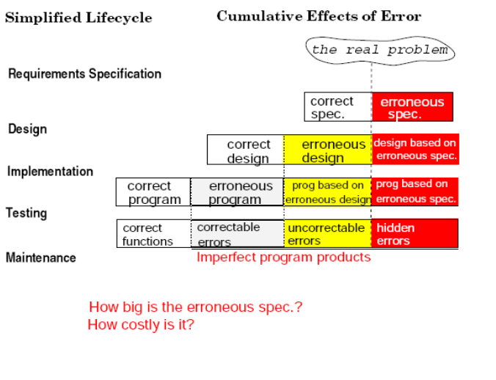

Slide 25
The Object Model
Object-oriented technology is built upon a sound engineering foundation, whose elements we collectively call the object model. The object model encompasses the principles of abstraction, encapsulation, modularity, hierarchy, typing, concurrency, and persistence. By themselves, none of these principles are new. What is important about the object model is that these elements are brought together in a synergistic way
that object-oriented
programming will be in the 1980s what structured programming was in the 1970s

Slide 26
• First-Generation Languages (1954-1958)
FORTRANI Mathematical expressions
ALGOL 58 Mathematical expressions
Flowmatic Mathematical expressions
IPL V Mathematical expressions
• Second-Generation Languages (1959~1961)
FORTRANII Subroutines, separate compilation
ALGOL 60 Block structure, data types
COBOL Data description, file handling
Lisp List processing, pointers, garbage collection
• Third-Generation Languages (1962-1970)
PL/1 FORTRAN + ALGOL + COBOL
ALGOL 68 Rigorous successor to ALGOL 60
Pascal Simple successor to ALGOL 60
Simula Classes, data abstraction
• The Generation Gap (1970-1980)
Many different languages were invented, but few endured

Slide 27
object-oriented programming
Object-oriented programming is a method of implementation in which programs are organized as
cooperative collections of objects, each of which represents an instance of some class, and whose
classes are all members of a hierarchy of classes united via inheritance relationships

Slide 28
Object-based vs Object-oriented
For a language to support inheritance means that it is possible to express "is a" relationships
among types,
For example, a red rose is a kind of flower, and a flower is a kind of plant.
If a language does not provide direct support for inheritance, then it is not object-oriented.
We define such languages by calling them object-based rather than object-oriented.
Under this definition, Smalltalk, Object Pascal, C++, Eiffel, and CLOS are all object-oriented, and Ada is object-based.

Slide 29
Kinds of Programming Paradigms
Procedure-oriented → Algorithms
Object-oriented →Classes and objects
Logic-oriented →Goals, often expressed in a predicate calculus, of which PROLOG (programming in logic)
Rule-oriented →If-then rules -> AI, rule based ML
Constraint-oriented →Invariant relationships -> form of declarative programming, Prolog III

Slide 30
Assembly
Procedural
Basic
C
Object-Oriented
C#
Java
Declarative
Prolog
SQL
Functional
Lisp
Haskell

Slide 31
Each of these styles of programming is based upon its own conceptual framework. Each
requires a different mindset, a different way of thinking about the problem. For all things
object-oriented, the conceptual framework is the object model
There are four major elements of this model:
• Abstraction
• Encapsulation
• Modularity
• Hierarchy
By major, we mean that a model without any one of these elements is not object-oriented.
There are three minor elements of the object model:
• Typing
• Concurrency
• Persistence
By minor, we mean that each of these elements is a useful, but not essential, part of the object model.

Slide 32
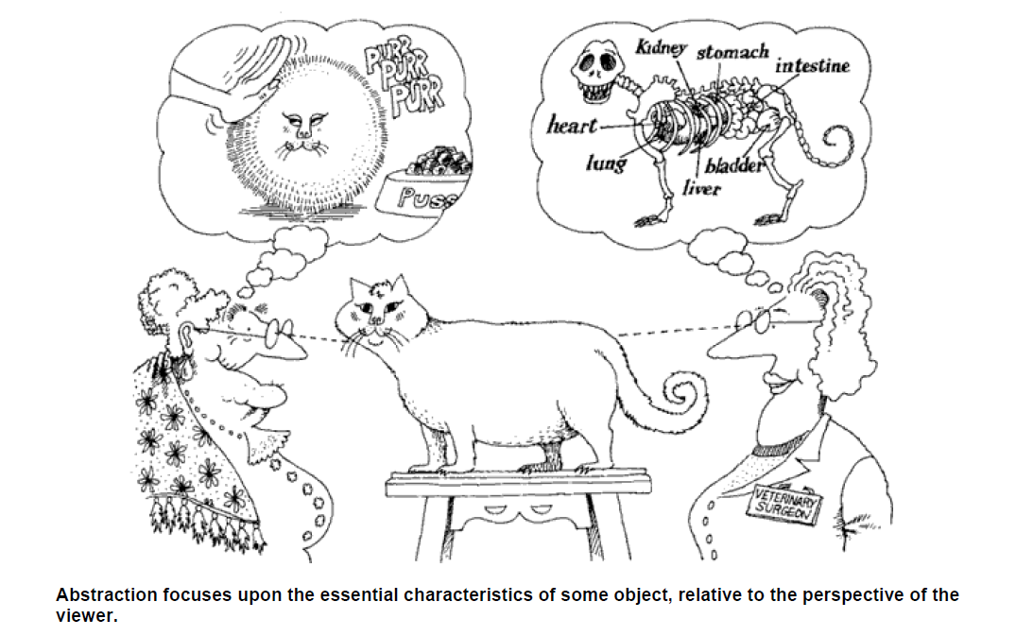
Abstraction
An abstraction denotes the essential characteristics of an object that distinguish it from all other
kinds of objects and thus provide crisply defined conceptual boundaries, relative to the perspective of
the viewer.

Slide 33
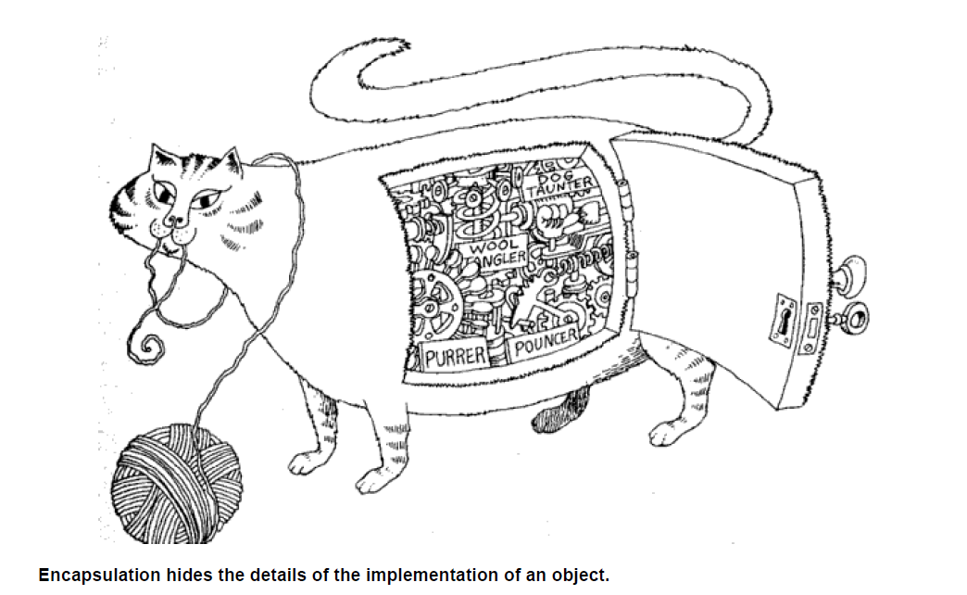

Slide 34

What is Object-Orientation
- Abstraction and Encapsulation
Abstraction
Focus on the essential
Omits tremendous amount of details
…Focus on what an object “is and does”
Encapsulation
a.k.a. information hiding
Objects encapsulate:
property
behavior as a collection of methods invoked by messages
…state as a collection of instance variables

Slide 35
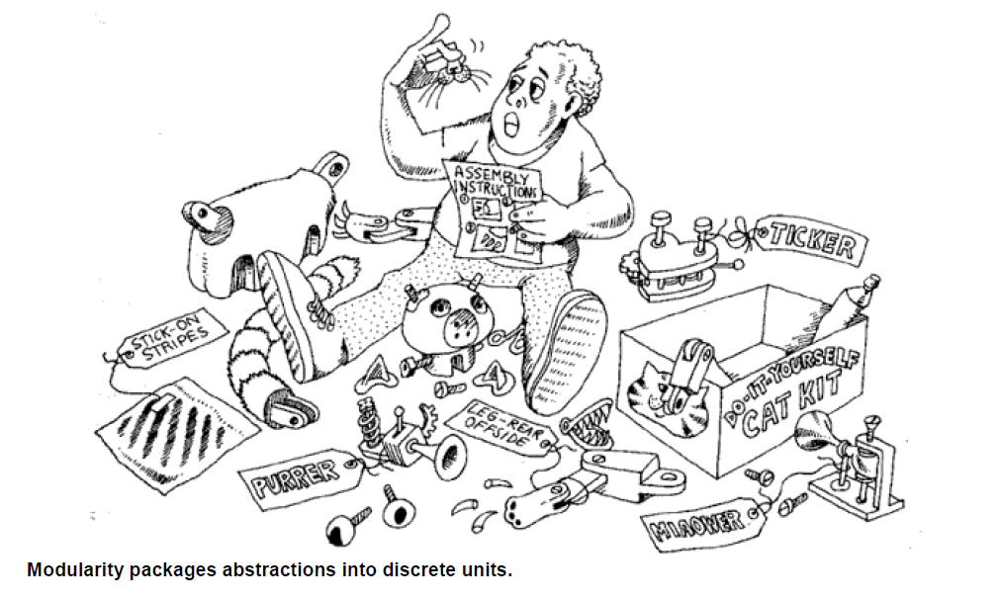
Modularity
Modularity is the property of a system that has been decomposed into a set of cohesive and loosely
coupled modules.

Slide 36
Hierarchy
Hierarchy is a ranking or ordering of abstractions.
Inheritance implies a generalization/specialization hierarchy

Slide 37
Typing
Typing is the enforcement Of the class of an object, such, that objects of different types may not be
interchanged, or at the most, they may be interchanged only in very restricted ways.
Examples of Typing: Static and Dynamic Binding

Slide 38
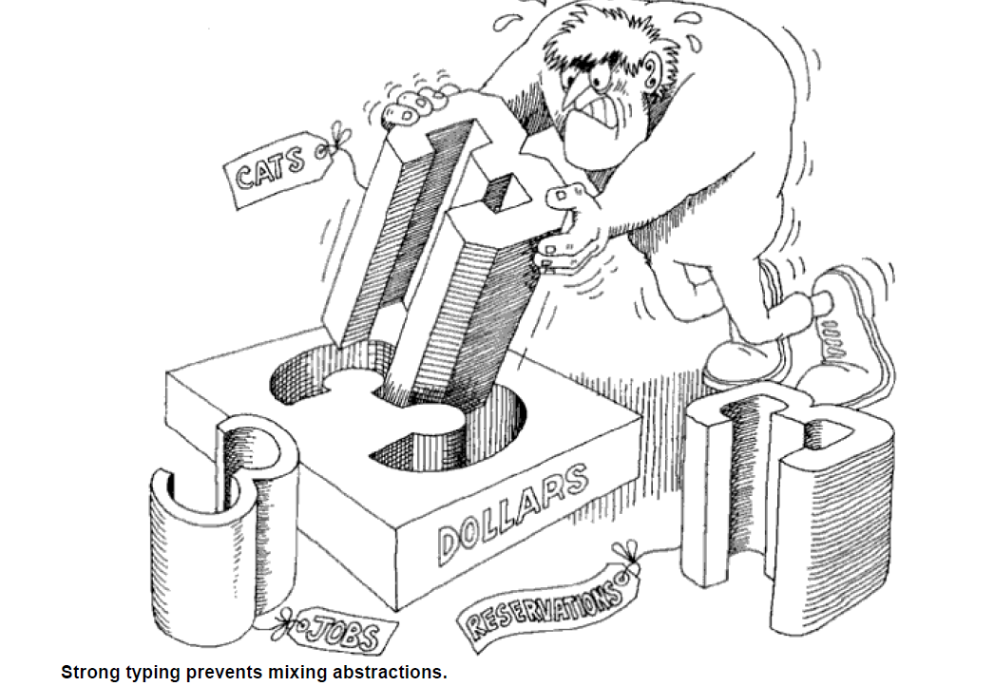

Slide 39
Concurrency
The Meaning of Concurrency For certain kinds of problems, an automated system may
have to handle many different events simultaneously.
Other problems may involve so much computation that they exceed the capacity of any single processor.
In each of these cases, it is natural to consider using a distributed set of computers for the target implementation or to use processors capable of multitasking.

Slide 40
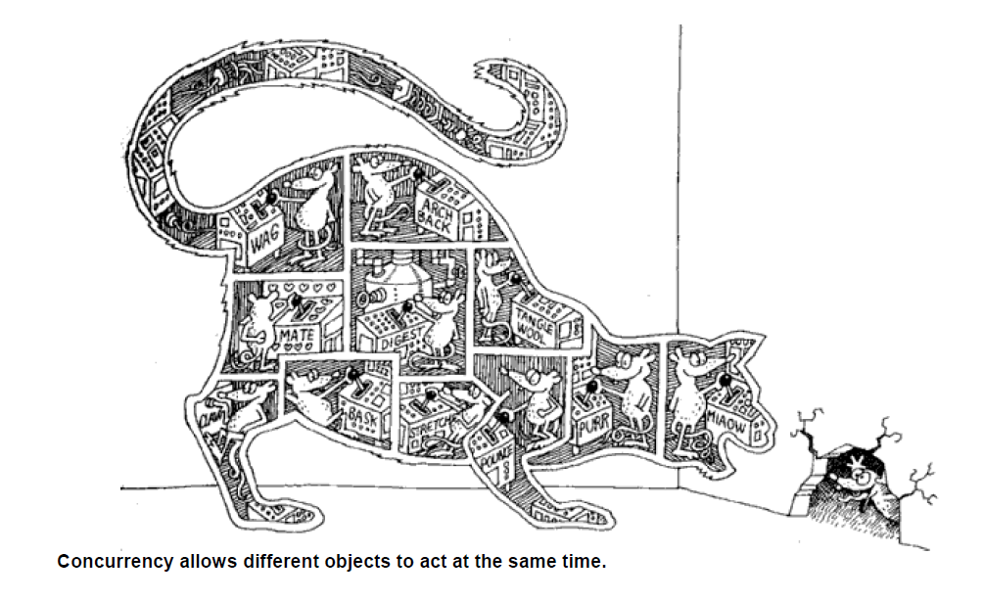
Heavyweight
process is one that is typically independently managed by the target operating system, and so
encompasses its own address space.
Lightweight
process usually lives within a single
operating system process along with other lightweight processes, which share the same
address space.
IPC

Slide 41
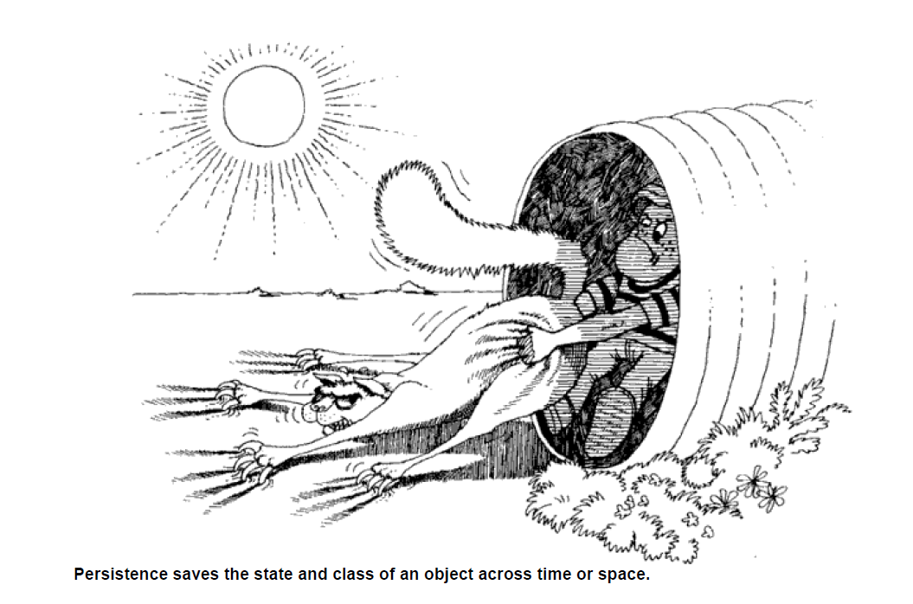
Persistence
An object in software takes up some amount of space and exists for a particular amount of
time.

Slide 42
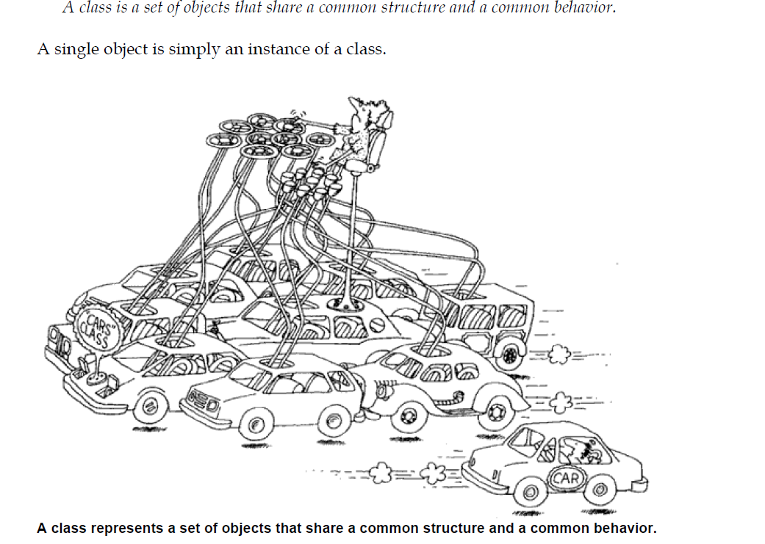

Slide 43
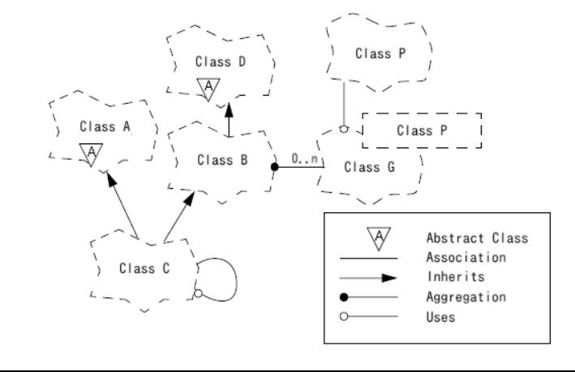
Class Diagram

Slide 44
What is Object-Orientation? - Class
<<instanceOf>>
Class Car
Attributes
Model
Location
#Wheels = 4
Operations
Start
Accelerate
<<instanceOf>>
<<instanceOf>>
What is CLASS?
a collection of objects that share common properties, attributes, behavior and semantics, in general.
A collection of objects with the same data structure (attributes, state variables) and behavior (function/code/operations) in the solution space.
Classification
Grouping of common objects into a class
Instantiation.
The act of creating an instance.

Slide 45


What is Object-Orientation? - What is Object?
An "object" is anything to which a concept applies
Things drawn from the problem domain or solution space.
E.g., a living person in the problem domain, a software component in the solution space.
A structure that has identity and properties and behavior
It is an instance of a collective concept, i.e., a class.

Slide 46
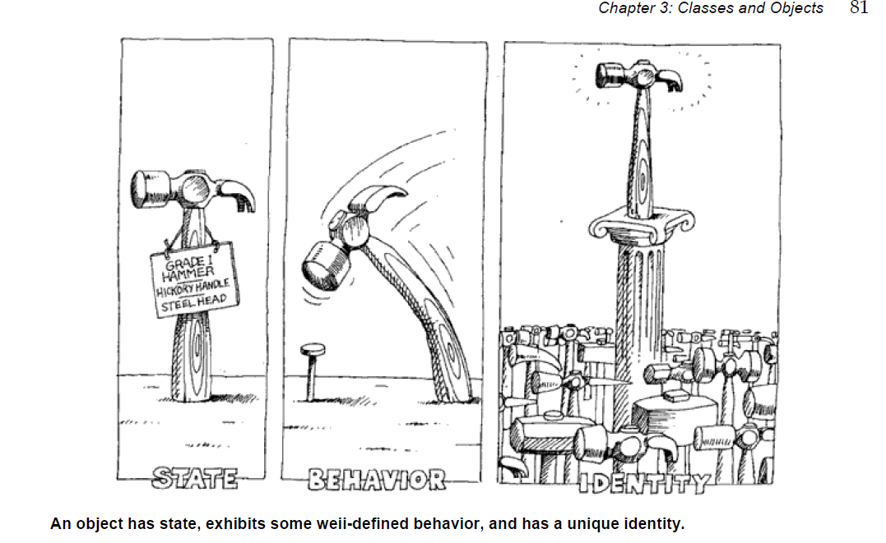
an object as a tangible entity that exhibits
some well-defined behavior.
An object has state, behavior, and identity; the structure and behavior of similar objects are defined
in their common class; the terms instance and object are interchangeable.
The state of an object encompasses all of the (usually static) properties of the object plus the current
(usually dynamic) values of each of these properties
Identity
“Identity is that property of an object which distinguishes it from all other objects "
Behavior
No object exists in isolation. Rather, objects are acted upon, and themselves act upon other objects. Thus, we may say that Behavior is how an object acts and reacts, in terms of its state changes and message passing.

Slide 47
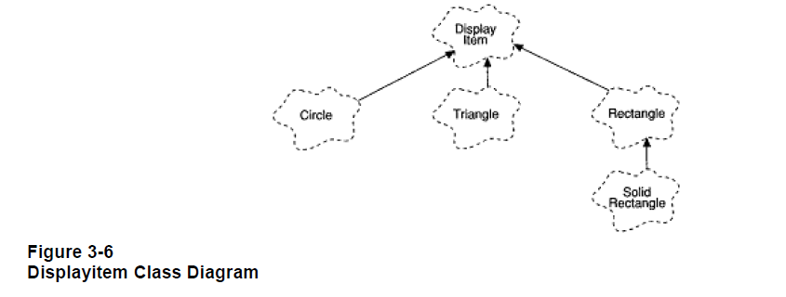
In the class DisplayItem, suppose that we define the instance variable theCenter
(denoting the coordinates for the center of the displayed item), along with the following
operations:
• draw Draw the item.
• move Move the item.
• location Retum the location of the item.
The operation location is common to all subclasses, and therefore need not be redefined, but
we expect the operations draw and move to be redefined since only the subclasses know how to
draw and move themselves.

Slide 48
Kinds of Relationships
• Association
• Inheritance
• Aggregation
• Using
• Instantiation
• Metaclass

Slide 49
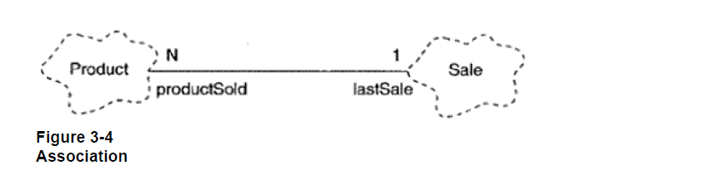
Association
Cardinality
Association is a “has-a” type relationship
• One-to-one
• One-to-many
• Many-to-many

Slide 50
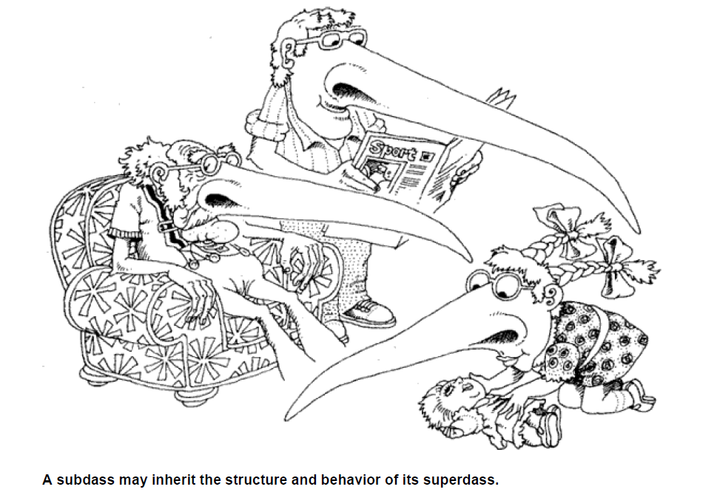
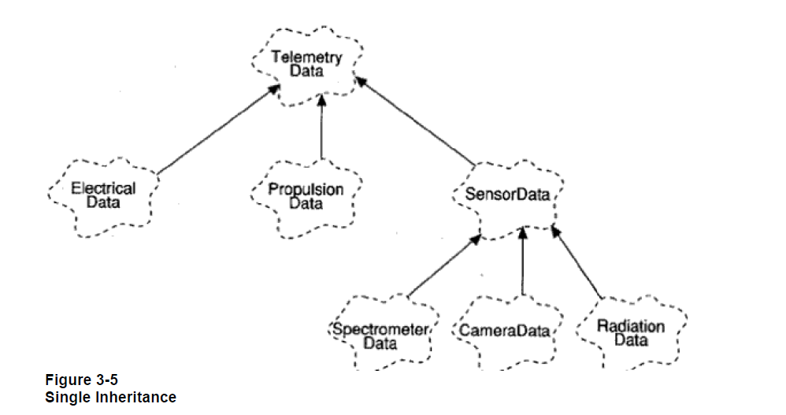
Inheritance
• Instances
• Subclasses

Slide 51
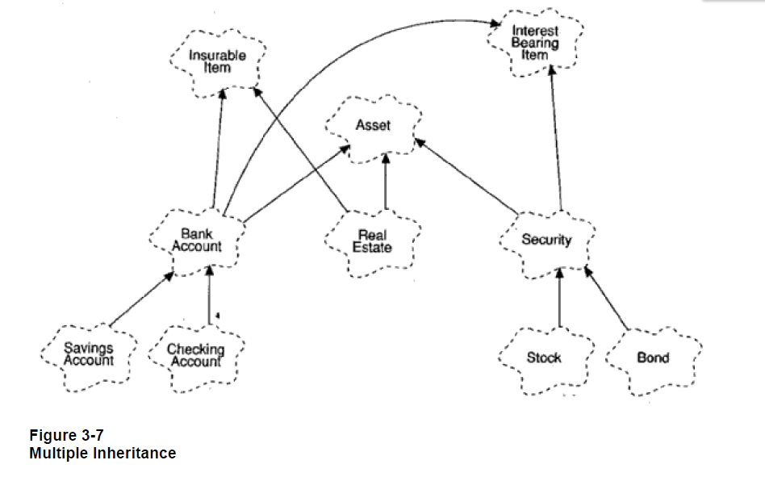

Slide 52
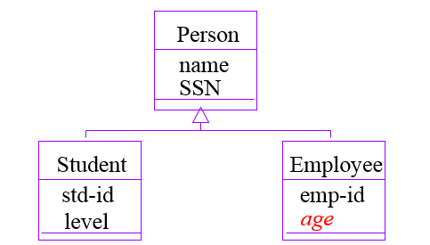
What is Object-Orientation
- Subclass vs. Superclass
Specialization: The act of defining one class as a refinement of another.
Subclass: A class defined in terms of a specialization of a superclass using inheritance.
Superclass: A class serving as a base for inheritance in a class hierarchy
Inheritance: Automatic duplication of superclass attribute and behavior definitions in subclass.

Slide 53
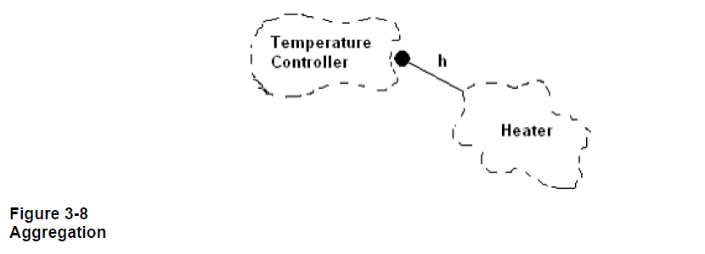
Aggregation is based is on "has-a" relationship
Aggregation is a one way association.
Example : “Student” and “address”
Aggregation
Example Aggregation relationships among classes have a direct parallel to aggregation
relationships among the objects corresponding to these classes

Slide 54
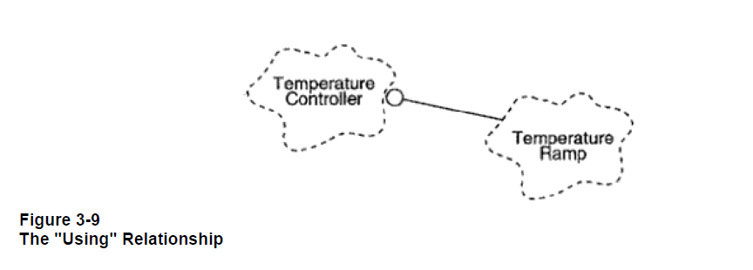
Clients and Suppliers "Using" relationships among classes parallel the peer-to-peer links
among the corresponding instances of these classes. Whereas an association denotes a
bidirectional semantic connection, a "using" relationship is one possible refinement of an
association, whereby we assert which abstraction is the client and which is the supplier of
certain services.

Slide 55
Composition: Composition is a "part-of" relationship. Simply composition means mean use of instance variables that are references to other objects. In composition relationship both entities are interdependent of each other for example “engine is part of car”, “heart is part of body”.

Slide 56
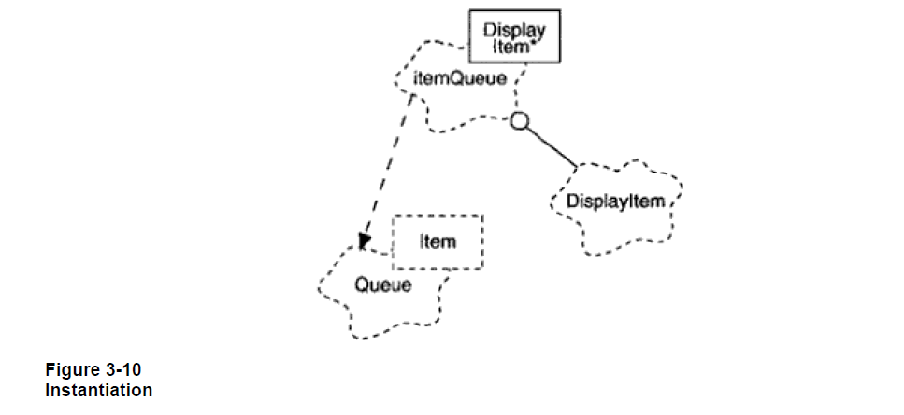
Queue<int> intQueue;
Queue<DisplayItem*> itemQueue;
instantiation The process of filling in the template of a generic or parameterized
class to produce a class from which one can create instances.

Slide 57
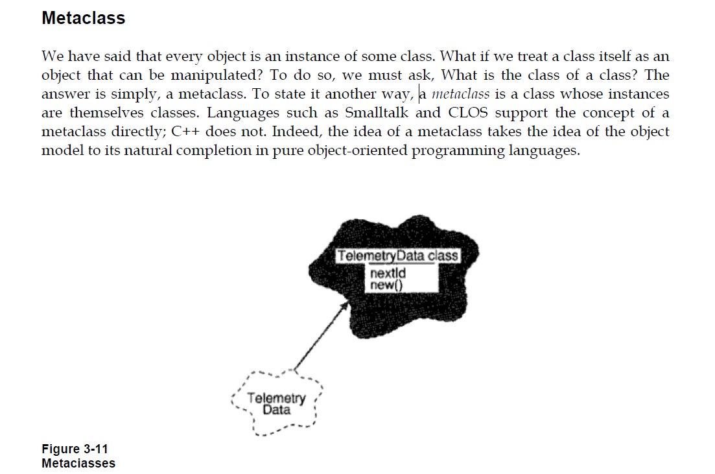

Slide 58
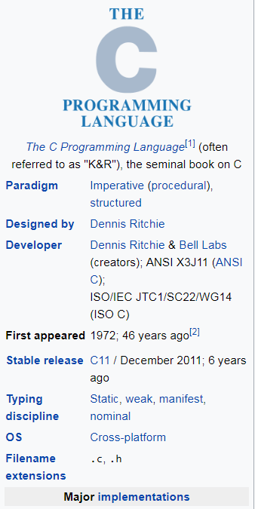
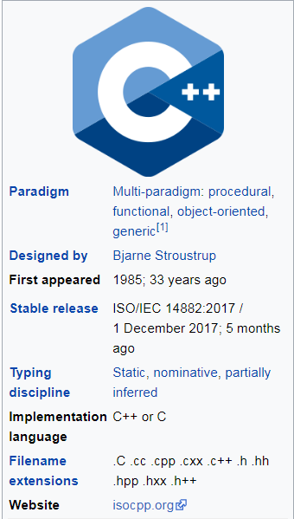
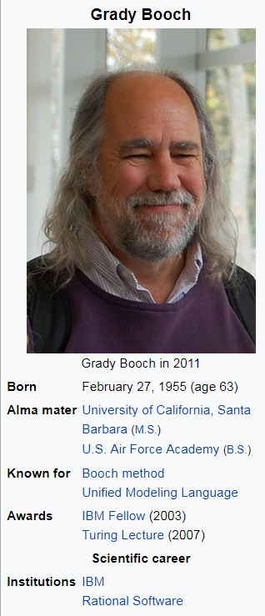
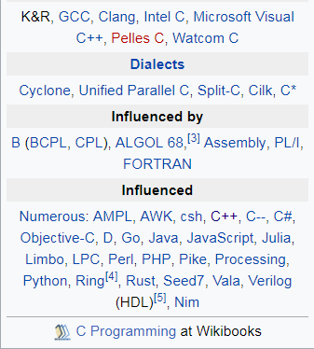
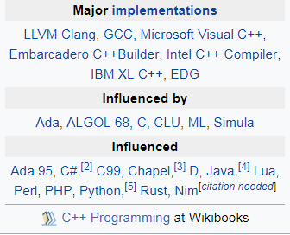


Slide 59
The Booch Method - OOD
In software engineering the Booch method, that is published in 1991 by Grady Booch, is a widely used method in object-oriented analysis and design.
The Booch method has been superseded by UML, which features elements from the Booch method with object-modeling technique (OMT) and object-oriented software engineering (OOSE).

Slide 60

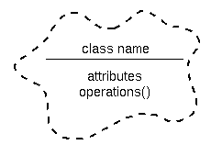
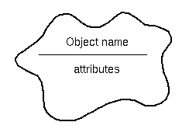
The Booch method notation
The Booch method helps to design systems using the object paradigm. It covers the analysis- and design phases of an object-oriented system. The method defines different models to describe a system and it supports the iterative and incremental development of systems.
Class diagram notation
Object diagram notation
The Booch method includes six types of diagrams such as class diagrams, object diagrams, state transition diagrams, module diagrams, process diagrams and interaction diagrams.

Slide 61
Model | Type | Diagram | UML correspondence
Logical | Static | Class diagram | Class diagram
 |  | Object diagram | Object diagram
 | Dynamic | State transition diagram | State chart diagram
 |  | Interaction diagram | Sequence diagram
Physical | Static | Module diagram | Component diagram
 |  | Process diagram | Deployment diagram

Slide 62
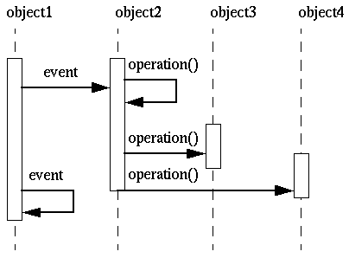
The dynamic nature of an application can be illustrated by state transition and interaction diagrams.

Slide 63
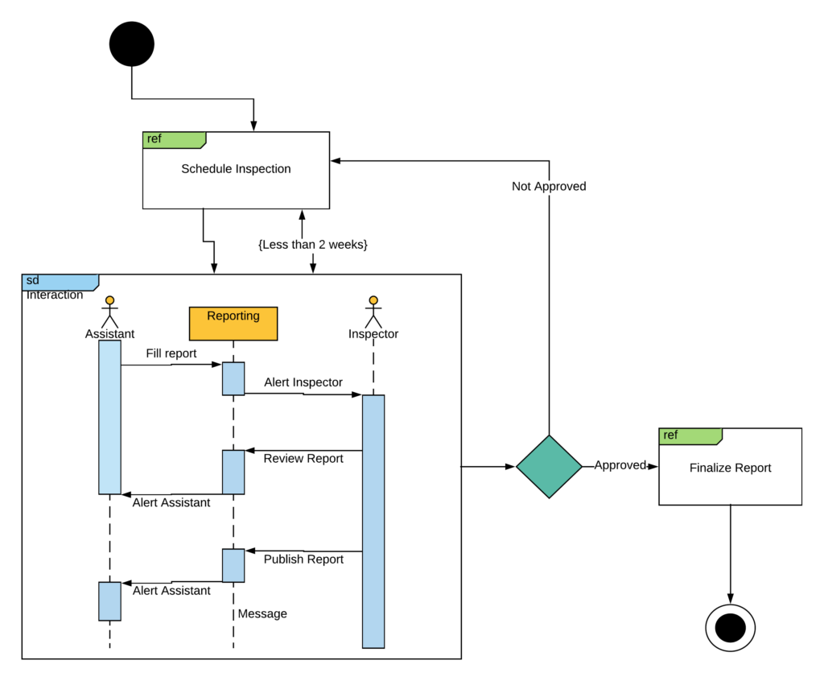
Interaction – Overview diagram

Slide 64
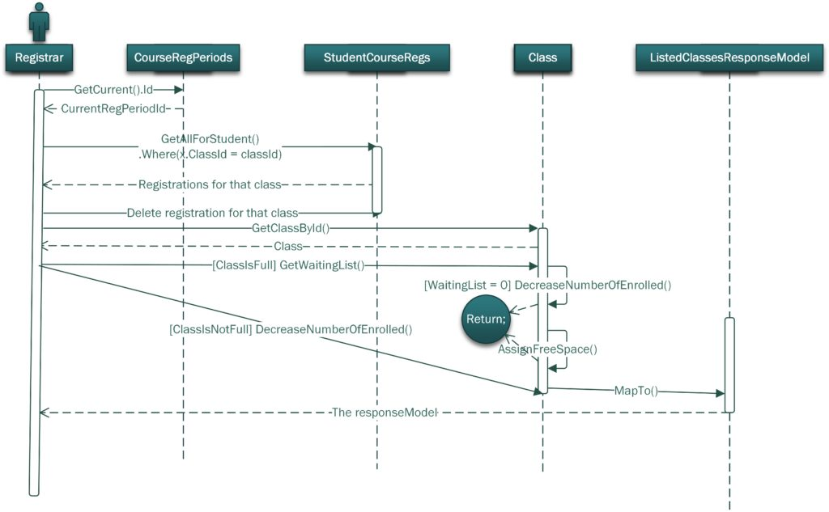
Sequence Diagram

Slide 65
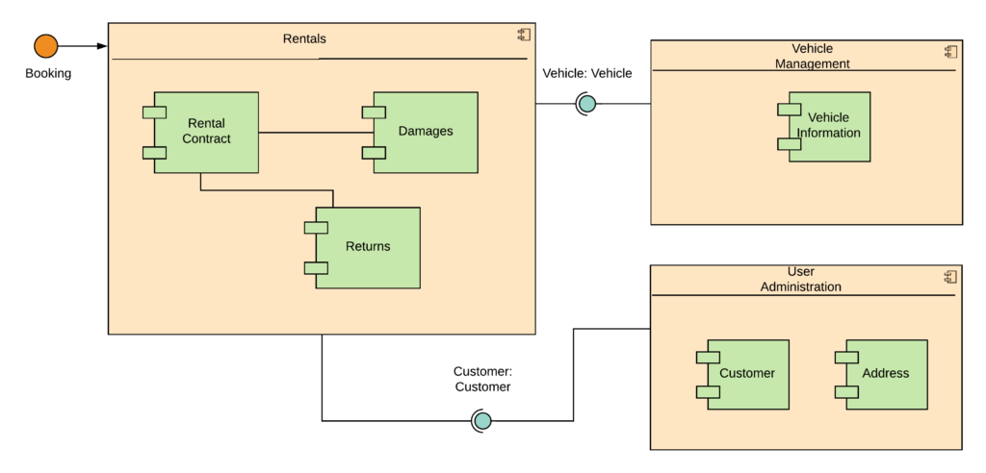
Composite Structure diagram

Slide 66
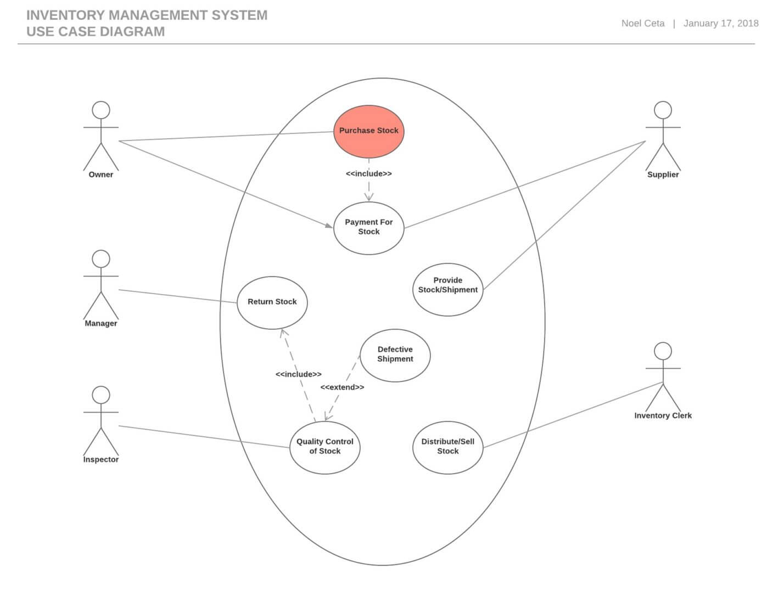

Slide 67
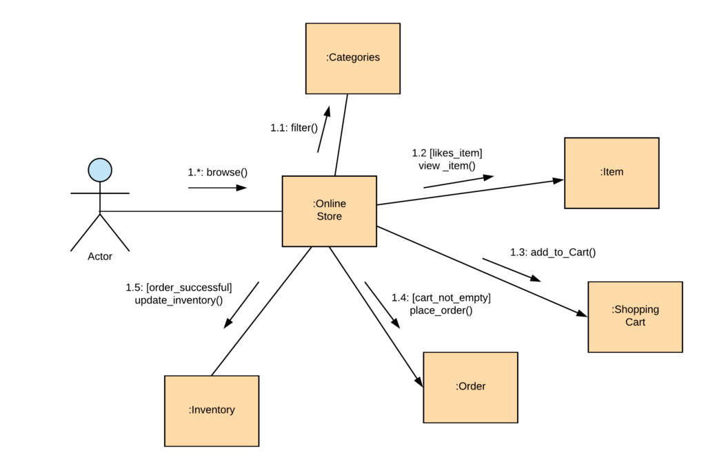
Communication Diagram

Slide 68
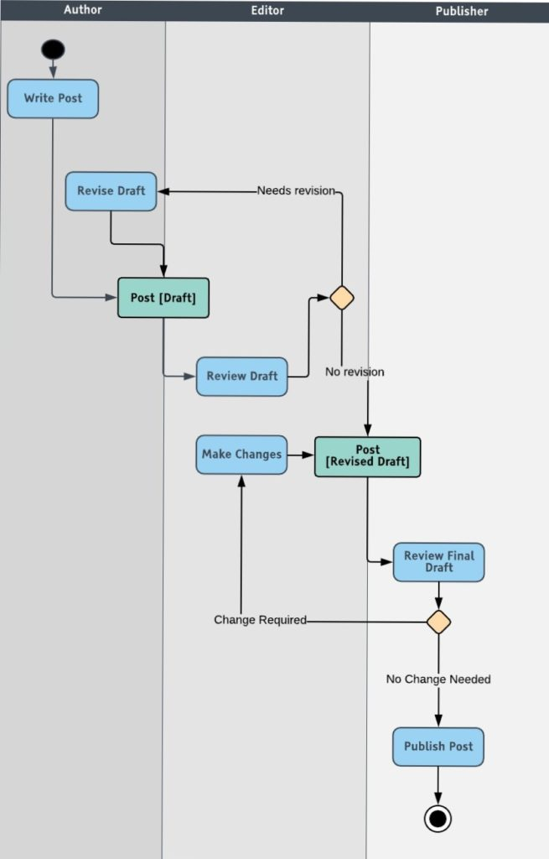
Activity Diagram

Slide 69
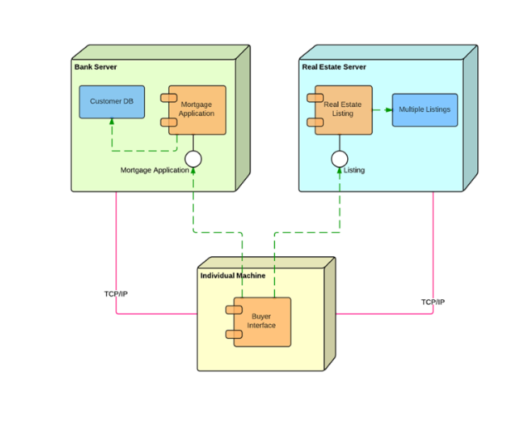
Deployment Diagram

Slide 70
Year | C++ Standard | Informal name
1998 | ISO/IEC 14882:1998^{[23]} | C++98
2003 | ISO/IEC 14882:2003^{[24]} | C++03
2011 | ISO/IEC 14882:2011^{[25]} | C++11, C++0x
2014 | ISO/IEC 14882:2014^{[26]} | C++14, C++1y
2017 | ISO/IEC 14882:2017^{[9]} | C++17, C++1z
2020 | to be determined | C++20^{[17]}, C++2a
version | description
C++98 | C++ 1998/2003 Standard
C++11 | C++ 2011 Standard
C++14 | C++ 2014 Standard
Non-standard | Non standard feature.

Slide 71
C++ is standardized by an ISO working group known as JTC1/SC22/WG21. So far, it has published five revisions of the C++ standard and is currently working on the next revision, C++20.
In 1998, the ISO working group standardized C++ for the first time as ISO/IEC 14882:1998, which is informally known as C++98.
In 2003, it published a new version of the C++ standard called ISO/IEC 14882:2003, which fixed problems identified in C++98.
The next major revision of the standard was informally referred to as "C++0x", but it was not released until 2011.^{[27]} C++11 (14882:2011) included many additions to both the core language and the standard library.^{[25]}
In 2014, C++14 (also known as C++1y) was released as a small extension to C++11, featuring mainly bug fixes and small improvements.^{[28]} The Draft
International Standard ballot procedures completed in mid-August 2014.^{[29]}
After C++14, a major revision C++17, informally known as C++1z, was completed by the ISO C++ Committee in mid July 2017 and was approved and published in December 2017.^{[30]}

Slide 72



Slide 73


